Slide 1
Array Initialisation & Assignment
ELEC1006: ENGINEERING COMPUTING

Slide 2

Array Initialisation
Arrays can be initialised with an initialisation list: const int SIZE = 5; int tests[SIZE] = {79,82,91,77,84};
The values are stored in the array in the order in which they appear in the list.
The initialisation list cannot exceed the array size.
PAGE 2

Slide 3
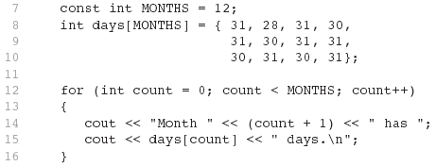
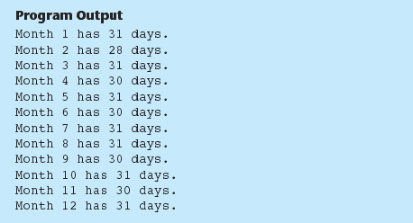
Example 1
PAGE 3

Slide 4
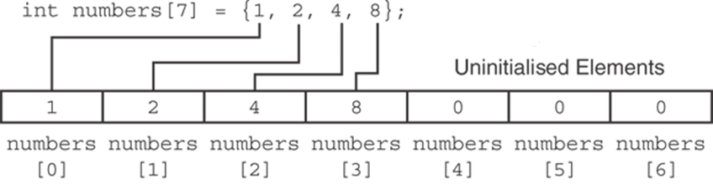
Partial Array Initialisation
If an array is initialised with fewer initial values than the size declarator, the remaining elements will be set to 0:
PAGE 4

Slide 5
Implicit Array Sizing
Can determine array size by the size of the initialisation list:
int quizzes[]={12,17,15,11};
Must use either array size declarator or initialisation list for array definition.
PAGE 5

Slide 6
Initialising an Array with a String
Character array can be initialised by enclosing string in " ":
const int SIZE = 6; char fName[SIZE] = "Henry";
Must leave room for \0 at end of array
If initialising character-by-character, must add in \0 explicitly:
char fName[SIZE] =
{ 'H', 'e', 'n', 'r', 'y', '\0'};
PAGE 6

Slide 7
Array Assignment
To copy one array to another,
Don’t try to assign one array to the other:
newTests = tests; // Won't work
Instead, assign element-by-element:
for (i = 0; i < ARRAY_SIZE; i++)
newTests[i] = tests[i];
PAGE 7

Slide 8
Printing String Contents of an Array
You can display the contents of a character array by sending its name to cout: char fName[] = "Henry";
cout << fName << endl;
But, this ONLY works with character arrays!
PAGE 8

Slide 9
Printing Numeric Contents of an Array
For other types of arrays, you must print element-by-element:
for (i = 0; i < ARRAY_SIZE; i++)
cout << tests[i] << endl;
PAGE 9

Slide 10
More info
[1] cplusplus.com: Arrays
https://www.cplusplus.com/doc/tutorial/arrays/
[2] leanrcpp.com: 6.1 – Arrays (Part I) https://www.learncpp.com/cpp-tutorial/61-arrays-part-i/
[3] learncpp.com: 6.2 – Arrays (Part II)
https://www.learncpp.com/cpp-tutorial/62-arrays-part- ii/
[4] learncpp.com: 6.3 – Arrays and loops
https://www.learncpp.com/cpp-tutorial/63-arrays-and- loops/
PAGE 10

